Slide 1
Alcohol and Drowsiness Detection System using ESP32
Arduino Ide
ESP32 Camera Module
MQ3 sensor

Slide 2

Aim:
The system will detect the early symptoms of drowsiness before the driver has fully lost all attentiveness and warn the driver that they are no longer capable of operating the vehicle safely.

Slide 3
Problem Statement:
The goal of the project is to detect drowsiness while driving and inform the driver at the appropriate time to avoid any mishaps.
The project employs a CNN model to determine whether or not a person is drowsy based on whether or not their eyes are closed or open.
The idea has a direct application in the vehicle sector, making driving safer and lowering the number of people killed in car accidents caused by drowsy driving.

Slide 4
Objectives:
The purpose of the drowsiness detection system is to aid in the prevention of accidents passenger and commercial vehicles.
The system will detect the early symptoms of drowsiness before the driver has fully lost all attentiveness and warn the driver that they are no longer capable of operating the vehicle safely.
This device will not, however, guarantee that the driver will be fully awakened and that an accident will be avoided.
It is simply a tool for improving driver safety; focusing primarily on long-haul truck drivers, nighttime drivers, people driving long distances alone or people suffering from sleep deprivation.

Slide 5
Methodology:

Slide 6
Requirement & costing
Sr. No. | Name of the component | Price
1. | ESP32 Camera Module | 680
2. | Gas Sensor(MQ3 sensor) | 210

Slide 7
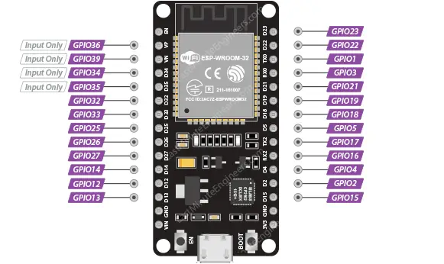
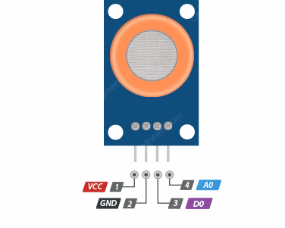
Components Overview:
ESP32
Gas Sensor (MQ3)

Slide 8
Implementation / Experimentation:

Slide 9
Result:

Slide 10
Conclusion:

Slide 11
References:
AIIT 2nd International Congress on Transport Infrastructure and Systems in a changing world(TIS ROMA 2019), 23rd-24th September 2019, Rome, Italy Use of eye tracking device to evaluate the “driver’s behaviour and the infrastructures quality in relation to road safety” David Vetturia, Michela Tibonib , Giulio Materninib, Michela Bonerab a DIMI – Università degli Studi di Brescia, Brescia 25125, Italy b DICATAM - Università degli Studi di Brescia, Brescia 25125, Italy
J Safety Res 2022 Feb;80:215-225. doi: 10.1016/j.jsr.2021.12.001. Epub 2021 Dec 13.”Physiological signal-based drowsiness detection using machine learning: Singular and hybrid signal approaches “Md Mahmudul Hasan , Christopher N Watling , Grégoire S Larue PMID: 35249601 DOI: 10.1016/j.jsr.2021.12.001.
International Journal of Engineering Applied Sciences and Technology, 2021 Vol. 6, Issue 4, ISSN No. 2455-2143, Pages 299-301 Published Online August 2021 in IJEAST (http://www.ijeast.com) “DRIVER DROWSINESS DETECTION USING PYTHON “Bhumika Rajput Department of Electrical Engineering Bundelkhand Institute of Engineering and Technology, Jhansi, India.
“Real-Time Driver’s Drowsiness Monitoring Based on Dynamically Varying Threshold” Isha Gupta, Novesh Garg, Apoorva Aggarwal, Nitin Nepalia and Bindu Verma Department of Computer Science Engineering Jaypee Institute of Information Technology, Noida, India

